Slide 1
Algorithmic Trading with R
How to lose money without really trying.
Notes:
Heard R described at the NoSQLx last week as “A DSL for statistics”
I totally disagree with this.
Despite its origins, R can be used for a variety of tasks of which only some of which are statistical. (True it does produce pretty graphs but there is much more ).
So want to introduce (briefly) what can be done in Real Time in R without any statistics or a graph in sight.
Could take a day/week or longer to discuss algorithmic trading so want to set out aims of talk.
I will need briefly to set out why you are listening to me tonight (in a couple of slides) but will gabble thru’ them.
Later I’ll talk a bit about algorithmic trading, per-se, before getting to grips with one way to do it in R.
Will post my slides (+ notes) online, so no need to scribble things down.
Notes a bit more extensive as they have useful (?) urls, document refs, etc…

Slide 2
Amis Consulting LLP
IT consultancy who reach the parts that other consultancies cannot reach.
1983-1997: Scientific computing and image processing.
1997-2003: Dotcom Boom (and bust) !!!
2003- Financial Systems.
Currently involved in High Performance Computing and (of course) Big Data and well as all the other stuff.
Notes:
1983/1997
First job was fingerprinting diamonds for S.A. company in London
Worked in aerospace in Boston, Rome and Munich on satellite imagery, reduced processing time of radar images to under one hour from 2 days.
Back in London with NHS at RPMS/Imperial – medical imaging and telemedicine
1997/2003
Web work (what else?) – mainly backend work for design companies.
However as well as LAMP systems we looked at Java (Tomcat/ jBoss)
Databases such as Postgresql; OpenLDAP
Also specialist document systems (BRS/Search), LDAP and early XML/SGML etc. Worked on DSSSL (lav joke?).
Put together specialist systems, configured and hosted them.
2003-present
Back-end systems and web solutions in financial institutions.
Unusual docbases: Documentum, Appian
Get involved Involved in trading desks and risk software.
Current interests
Jointly run an HPC meetup group
Putting together an analytics group for M2M data, starting on AWS moving to self-hosting when successful.

Slide 3
Worked with a variety of technologies
Languages (in anger): Fortran / C / Ada / Perl / Python / Lisp / Java / PHP /Groovy … … our GOTO languages remain C and Perl but ???
Back-ends Unix (not just Linux) and Windows (so some .NET)
Databases Both relational and the NoSQL stuff
Moving into the cloud AWS: Map-reduce, (excited about) Redshift.
Notes:
In anger means someone paid us for the software.
Lots of other languages – procedural all pretty similar, have more problem with thinking functionally.
Still use Perl for data munging but since the Perl 6 fiasco, Python clearly has won, so trying to get in a Python state of mind.
Unix: Solaris, HPUX, AIX as will as the Redhat and Debian mob.
Database:
SQL – Started with Oracle (V2), there as one;
Also Sybase but Bill Gates came along and Ingres pre-Postgres
MariaDb is the one to watch since Oracle bought and trying to destroy MySQL
NoSQL - KeyVal: Berkeley, Redis,
Columnar: Cassandra
Docbase: Mongo and Couch
Cloud: Amazon has won (over Google) for my needs.

Slide 4
Then along came R …
At Kings in late-2000’s
Interest was in HPC (mainly CUDA) applied to financial systems.
Started using Matlab but was looking for a similar type package for personal/company usage .
Gnu/Octave and R both fitted the bill, R won.
One new option ( -- more later --)
Notes:
Was at Kings (not 100%) when Lane Houston was running the Finance group in the Maths dept.
They were putting together an HPC ring based on Nvidia graphics processors.
We had interest from our German work on STAR-100 and SGI (at Imperial)
Also started to use Matlab but post-Kings were looking for an O/S option.
GNU had Octave which is slow even by Matlab Standards but pretty compliant.
The French have Scilab (any French here ?) which is not; also Freemat
R is functionally equivalent – for what I wanted.
Now interested in a new kid on the block.

Slide 5
R in Finance
(My) Taxonomy of R financial packages
CRAN has a Finance view: http://cran.r-project.org/web/views/Finance.html
Econometrics
Rmetrics Group
Quantmod
“TITs”
Notes:
Original aims of talk to focus on using R in Finance.
Taken off over last 6 months: R/Finance 2013 ( www.rinfinance.com )
There is a web view page on CRAN which is the best place to start.
Econometrics is the application of mathematics, statistical methods, etc. to economic data.
Need estimates of stock behaviour (viz. volatility) to price options (say)
There is an econometrics page on CRAN.
Rmetrics Association is based in Zurich; provide books, training courses and an annual meeting on R-Finance, also a few (free) webinars. (www.rmetrics.org)
The concentrate on a series of f* packages: fBonds, fOptions, fCopulae, fAsianOptions … and bundle these together in an easy to manage install.
Quantmod ( not to be confused with RQuantLib, which is a wrapper using Rcpp/C++)
Author is Jeffery Ryan (www.quantmod.com)
The quantmod package for R is designed to assist the quantitative trader in the development, testing, and deployment of statistically based trading models.
Will be talking later about Jeff’s work so leave it until then.
Then there are the Tits.
Next slide is of a pair of Tits ….

Slide 6
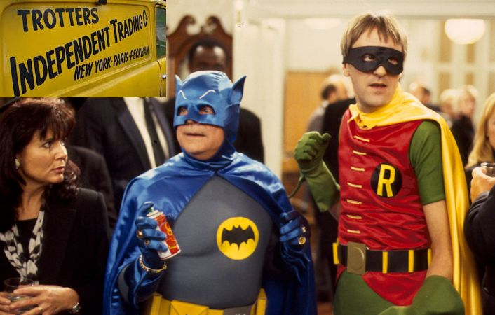
A Couple of TITs
Notes:
Tits : Trotters Independent Traders
Anyone who writes a package and decides to share it with the R-World becomes a TIT, if not one already.
There are GREAT tits, LITTLE tits, even (possibily) BLUE tits.
So not a form of derision – genuine admiration.
R packages have exploded in past 18 months (doubled ??) so important to sort-out the wheat from the chaff.
R-Forums help, otherwise suck-it-and-see.
Revolutions are good here:
They have a blog page on Jeff Ryan:
http://blog.revolutionanalytics.com/2011/07/the-r-files-jeff-ryan.html

Slide 7
Algorithmic Trading
You will need:
Data Feed Yahoo Financials, Pay for feeds, Platform API
Analysis Python, C/C++, C#, R + … others
Trade Metatrader, NinjaTrader, TradeStation, ThinkOrSwim …
Cash !!!
Notes:
Pretty self explanatory: Using an algorithm to execute programmed trading instructions without human intervention.
Used widely by investment banks, pension funds, mutual and hedge funds.
Need a data feed – payment not an option for the individual (£2/3 pm Bloomberg)
So looking at a Platform API.
Then analysis R and Matlab are popular, Python becoming increasing so.
Finally a way to trade:
Metatrader: Daddy of FX trading (currently v 5, script is MQL5)
NinjaTrader: NinjaScript, C# API
TradeStation: EasyLanguage
ThinkOrSwim: thinkScript, API (at least) Java, Python
All have online websites and you tube presentations.
Worth looking at for information if nothing else.

Slide 8
Real-time Trading (with IBrokers)
ACL use Interactive Brokers ( not always in R ) https://www.interactivebrokers.co.uk/
A feed to do real-time trading.
Java Application (TWS) and a Web-Trader Interface
Good documentation and phone support.
API which can be accessed via C, Java, .Net, Excel
Several other languages exist, including at least one R package.
Notes:
We use InteractiveBrokers.
http://www.brokerage-review.com/findbroker/proscons/interactivebrokers.aspx
Pros: (& Cons listed there too).
Low stock commissions for orders with 1,000 shares or less
Professional trading platform
Best margin rates
Access to many markets
Rich selection of products for trading.
Provide a Java app (TWS), webtrader and mobile trader – so you can keep losing money where ever you are.
I’ve found the documentation good and the usual videos and webinars.
Plus 3rd party youtube-rs.
Not unsuprisingly, the R-Package is the subject of the talk.

Slide 9
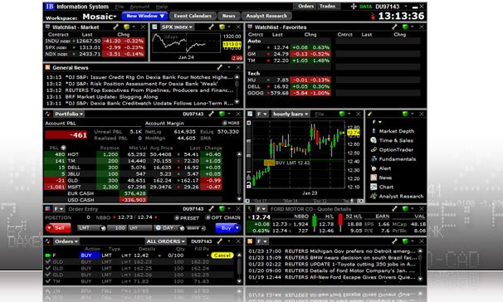
Interactive Brokers – Trader Workstation
Notes:
Worth looking at TWS interface.
Java app ( there is a JNLP available too )
The Mosaic is a “dashboard” style with usual drag’n’drop, panel resizing.
Panels can be docked or floating.
Two accounts: Paper and Trading.
Separate login credentials and (naturally) the Trading account is much more secure.
Dashboard layout can be locked in which case it is saved to the server of the preferences are reloaded at login.
Panels with:
Information on (selected) stocks.
User’s trade book
News
Graphics (various)

Slide 10
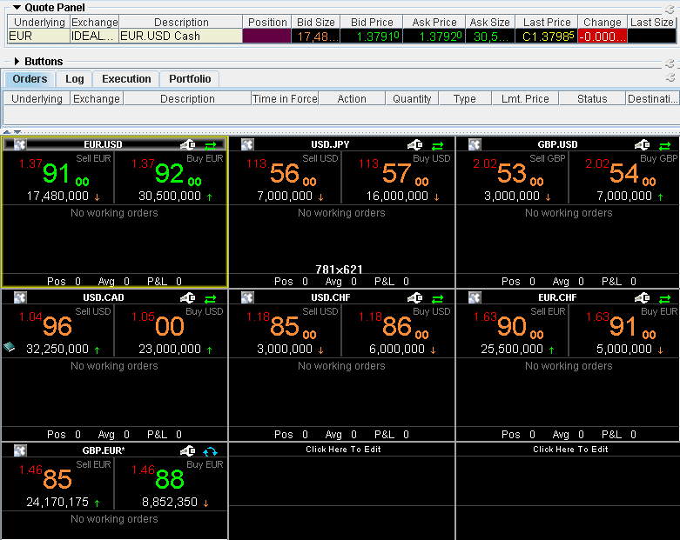
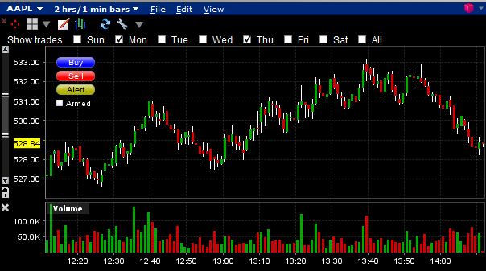
TWS Mosaic Panels
Forex trading
AAPL stock movement
Notes:
A couple of panels.
LHS: Forex
RHS: Apple (AAPL) stock

Slide 11
More on Algorithmic Trading
Moving average Closing prices, Yahoo/Google Financials
Historical data Back testing
Real time Forex, Stocks, Options, Futures
High frequency trading Black Arts, not for us
Notes:
Many people still trade on moving averages.
In a sense its what you do if you look at the prices and buy thorough a broker such as Hargreaves-Lansdown.
There are strategies based on moving average and in this case you only need closing prices (say) which are available from Yahoo.
Historical data is needed for “back testing” of any algorithm before risking real cash.
Real time (not going to give strategies)
Moving average: Short-term vs long-term cross over.
Trends: Based on trend derivatives (2nd ???)
????:
High Frequency trading is not the subject of this talk, would not use R or Broker API
The primary purpose of dark pools is to minimise market impact.
By restricting access to undesired market participants (such as high frequency trading firms), and by not revealing quotes, dark pools enable institutional investors to minimise their information leakage and realise more efficient executions.

Slide 12
How do I start?
Setup IB account. Read the documentation and look at the videos / webinars.
Use the “Paper” Account . Forex, Stocks, Options …
Use the TWS and/or Web-trader with real money.
Formulate your algorithmic strategy.
Program it.
Goto the PUB.
Notes:
Setting up an account costs.
IB want $10K (£7K) startup fund … but you can transfer most of it back out.
Important to get a hang of trading via the Paper account, don’t risk some algorithmic stuff on the live.
Probably stocks is easiest to start with.
There is lots of advice on line.
For starting try www.wildbunny.co.uk -- a gamer blog, parts 1 and 2 -- 3 is promised.
Also Algorithmic Trading and DMA: An introduction to direct access trading strategies
Amazon down from £31.00 to £8.70
Since we are talking R then possibly you would do that but there are other possibilities.
I’ve put the reference to a moving average strategy using QUANTMOD in the notes
(from gekkoqquant.com)
http://gekkoquant.com/2012/08/29/parameter-optimisation-backtesting-part1/
BTW: Don’t goto the PUB – nasty things can happen if you get it wrong.

Slide 13

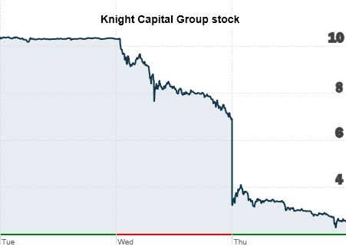
How to Test Your New Market Making Software and Lose a Pile of Money, Fast
Wednesday, 1st August 2012
Notes:
The glitch from hell is just waiting for its moment ….
… it happened on 1st August last year when Knight Capital deployed some new software.
In the words of the Securities and Exchange Commission,
On Aug. 1, 2012, “Knight Capital traded more than 397 million shares, acquired several billion dollars in unwanted positions and eventually suffered a loss of more than $460 million.”
In fact they could not meet the $460 loss by the end of the trading day so a rescue plan was cobbled up to allow then to resolve the commitments.
Knight Capital had struck a deal with Jefferies, TD Ameritrade, Blackstone, GETCO, Stephens, and Stifel Financial, staving off collapse days after the trading mishap and eventually sold itself to GetCo. They were also fined $12 million by the SEC
KC dropped from over $10 per share to around $7 and was marked down to under $4
The phrase Knightmare on Wall Street was to good to miss.
Why? ….

Slide 14
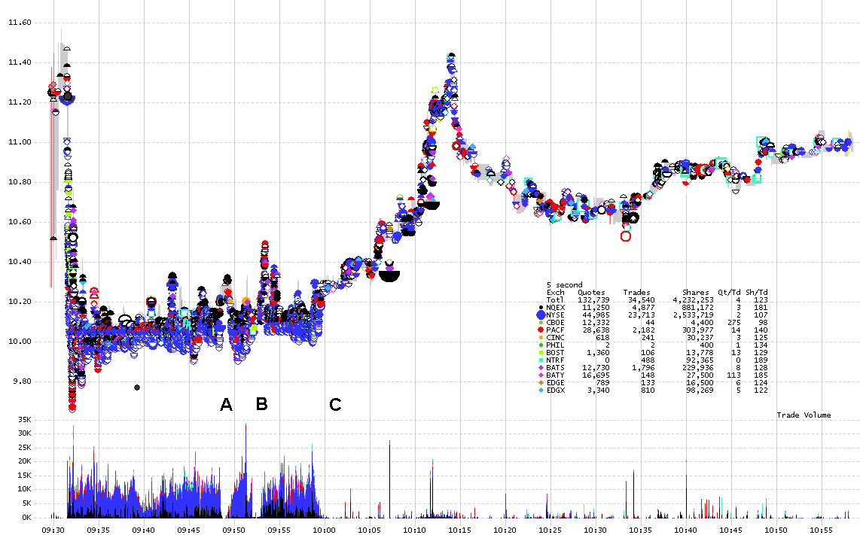
Nanex : 5 second interval chart showing all trades colour coded by exchange
Notes:
This is the Nanex chart of trading on the 1st August.
There is a fully account of what happened at the time at:
http://www.nanex.net/aqck2/3522.html
Also the Edgar Perez book (frontispiece over leaf):
www.knightmareonwallstreet.com
All damage do in 40 minutes from the exchange opening …

Slide 15
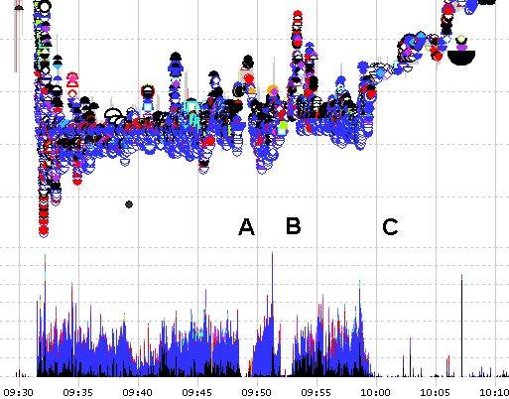
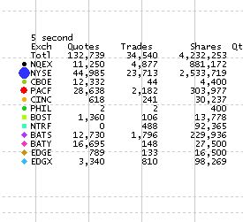
Fatal First Forty minutes
http://www.nanex.net/aqck2/3522.html
Notes:
(Can’t resist the alliteration)
Blue are trades on NYSE -- Volume 112% of daily in first 10 minutes.
From about 10.10 normal trading resumes
There were a couple of times when KC switched it off, thought they had fixed the problem and switched it back on again !!!
Initial conclusion (and Perez’s) is that KC got the Bid and Ask prices revised for kept thinking “here’s” a good deal and buying back their sales losing on the spread each time.Basket of 40 shares (to memory) on NYSE but large volumes.
Word on the street as it was “test” software which did not have the necessary stops in place to limit losses or that the stops were there but in the wrong place, which is almost true …
The SEC said two mistakes led to the breakdown. The first occurred in 2005. According to the SEC, a section of code in an automated equity router was moved to an earlier spot in the code sequence. As a result, one of the router's functions became defective. In July 2012, Knight incorrectly deployed new code in the same router which triggered the defective function, which couldn't recognize when orders had been filled.
http://www.sec.gov/News/PressRelease/Detail/PressRelease/1370539879795#.UmaWdfmsh8E

Slide 16
Why Use R as a trading platform
Advantages
Flexible, powerful language
Best of class tool chain
Community, open source, cross-platform
Disadvantages
Single threaded
Not as quick as C/C++
Notes:
< Just read bullets >

Slide 17
IBrokers: R package (1)
Connections R has a native socket interface providing relatively high performance.
Threads Single-threaded R makes true “threading” impossible.
Data Persistence and Sharing Closures allow for single process data persistence among calls.
Thorough-put Event REPL bounded by costly R loops Message structure dependent
Notes:
I-Brokers is a package downloadable from CRAN.
It is in native code (i.e. not a wrapper like Rquantlib) and to my mind the coding is exquisite.
So if you only want to look at beautiful code, look at this package.
It works by establishing a socket <-> socket connection with the TWS, so this must be running when IBrokers is called. TWS prompts that an incoming call as been requested and should it be allowed.
Since R is single-threaded so is the package.
However there are ways around this: Ethan McCullum spoke just a year ago on parallelization ( -- I remember the mince pies).
R is a LISP in sheep-clothing ( did you know that? ) so its possible to utilise closures to provide for non-blocking persistence.
This means implementing a Read-Execute-Process loop passing messages back to the event routine.

Slide 18
IBrokers: R package (2)
Authored by Jeff Ryan Member of the “Quant Mods”, his first cut 2008, revised 2012
Works via the Trader Workstation API Uses this for authentication and for the data feed
Establishes a socket to socket local connection
Written in almost native R, not a wrapper
Revised version almost complete implementation of IB API
Notes:
As said the author is Jeff Ryan.
Chicago based and very active in the R-world for around O10 years.
He’s a committee Member at R/Finance : http://www.rinfinance.com …
… and Owner/Principal at Lemnica : www.lemnica.com
There are some interesting stuff on R on the Lemnica site.
Authored: xts, quantmod
Relies on: zoo, timeSeries, timeDate,tseries, its, chron, fts, tis
In 2008 Jeff had a first go at the IBrokers package but that was pretty incomplete.
In 2012 greatly expanded and added functionality, much to my pleasure as we thought we’d have to tackle it.
Because TWS is used for authenication it does not have to worry about maintaining the datastream.

Slide 19
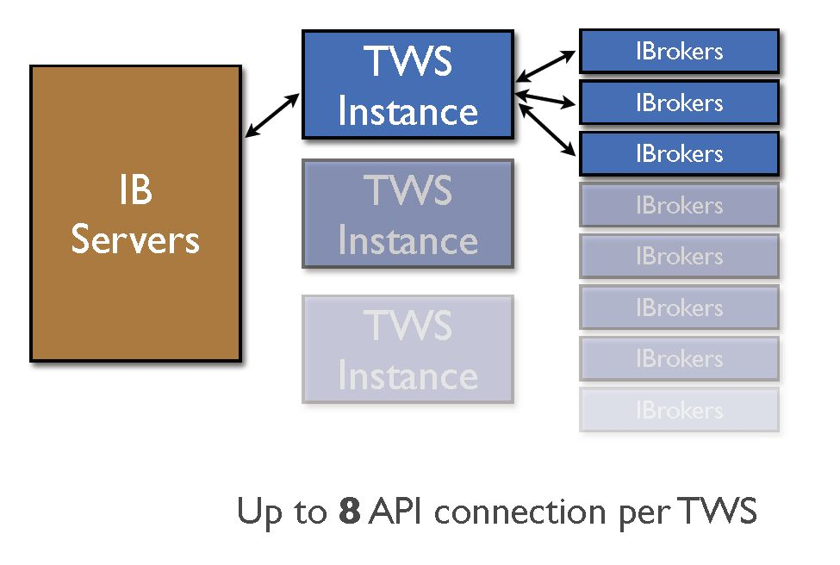
Notes:
Although R is single threaded one TWS instance can support 8 connections through its API.
Multiple instances (on separate machines?) can communicate with the IB server.

Slide 20
IBrokers : R Implementation
Historical Data : reqHistoricalData Direct access to IB historic data
Real Time Data : reqMktData, reqRealTimeBars Live market data – stocks, options, futures, FX
Live Execution : placeOrder, cancelOrder, reqAccountUpdates Place and cancel orders View account information
Notes:
The IBrokers package provides all the functionality needed to trade with IB-TWS
Possible to get :
historical data for back testing
realtime data for algorithmic analysis
place/cancel orders
Also have access to user’s account data.
To quote Jeff Ryan’s (caveat emptor) :
Orders via the API are quite complicated, or at least can be. It is strongly advised to only proceed with trading real money after one understands not only all the R code in this package, but the official API as well.
If you are more comfortable clicking shiny buttons in a GUI, it is probably better that you keep clicking the buttons and not pretend to program. Not for the faint of heart. All profits and losses related are yours and yours alone. If you don’t like it, write it yourself.

Slide 21
Using IBrokers from R
A quick example of capturing data to disk:
library (IBrokers)
tws <- twsConnect()
aapl.csv <- file("AAPL.csv", open="w")
reqMktData (tws,
twsSTK("AAPL"),
eventWrapper = eWrapper.MktData.CSV(1),
file = aapl.csv)
close(aapl.csv)
close(tws)
Be familiar with the IB API documentation on a call as well as the R implementation (viz.)
https://www.interactivebrokers.com/en/software/api/apiguide/c/reqmktdata.htm
Notes:
This is as an “Hello World” moment as I can get.
Make a connection.
Open a file for writing
Get the Apple stock price via reqMktData
On termination (^C) close the file and shutdown the connection
Important to understand the IB API not just the IBrokers implementation of it.
Note: There is a C and Java guide for the API

Slide 22
Real Time Data Model (1a)
> reqMktData(tws, twsFUT("NQ","GLOBEX","201309"))
<20130629 11:17:13.117602> id=1 symbol=NQ Volume: 0
<20130629 11:17:15.323245> id=1 symbol=NQ bidPrice: 1480.75 bidSize: 8
<20130629 11:17:15.324615> id=1 symbol=NQ askPrice: 1481.25 askSize: 19
<20130629 11:17:15.325706> id=1 symbol=NQ bidSize: 8
<20130629 11:17:15.326655> id=1 symbol=NQ askSize: 19
<20130629 11:17:15.327537> id=1 symbol=NQ lastPrice: 1480.75
<20130629 11:17:15.328335> id=1 symbol=NQ lastSize: 1
<20130629 11:17:15.329518> id=1 symbol=NQ lastTimestamp: 1246313805
Notes:
This is a reqMktData call for a Futures contract on the Nasdaq-100 (NQ)
Using the CME Globex exchange
Typical line has a time stamp, id (position in the list), symbol type plus information as key: value (pair)
Normally sequentially but information such as askPrice and associated Size given together

Slide 23
Real Time Data Model (1b)
> reqMktData(tws, list(twsSTK("MSFT"),twsSTK("AAPL")))
<20131029 13:34:55.649897> id=1 symbol=MSFT Volume: 622549
<20131029 13:34:55.652436> id=1 symbol=MSFT highPrice: 24.03
<20131029 13:34:55.653531> id=1 symbol=MSFT lowPrice: 23.55
<20131029 13:34:55.656226> id=1 symbol=MSFT shortable: 3.0
<20131029 13:34:55.657129> id=1 symbol=MSFT bidPrice: 23.89 bidSize: 2
<20131029 13:34:55.658781> id=1 symbol=MSFT bidSize: 2
<20131029 13:34:55.659603> id=1 symbol=MSFT askPrice: 23.9 askSize: 30
<20131029 13:34:55.660695> id=1 symbol=MSFT askSize: 30
<20131029 13:34:55.850867> id=2 symbol=AAPL bidPrice: 141.82 bidSize: 1
<20131029 13:34:55.852082> id=2 symbol=AAPL askPrice: 141.9 askSize: 6
<20131029 13:34:55.853202> id=2 symbol=AAPL lastPrice: 141.95
<20131029 13:34:55.854040> id=2 symbol=AAPL bidSize: 1
<20131029 13:34:55.854956> id=2 symbol=AAPL askSize: 6
Notes:
Its possible to request market data on more than one stock
Typical line has a time stamp, id (position in the list), symbol type plus information as key: value (pair)
Normally sequentially but information such as askPrice and associated Size given together

Slide 24
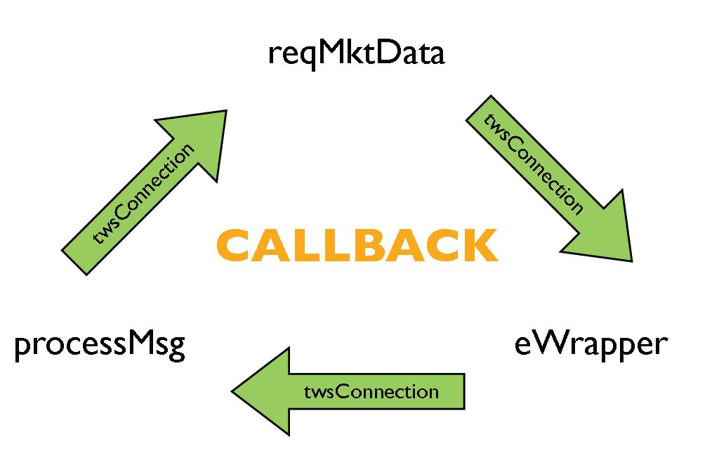
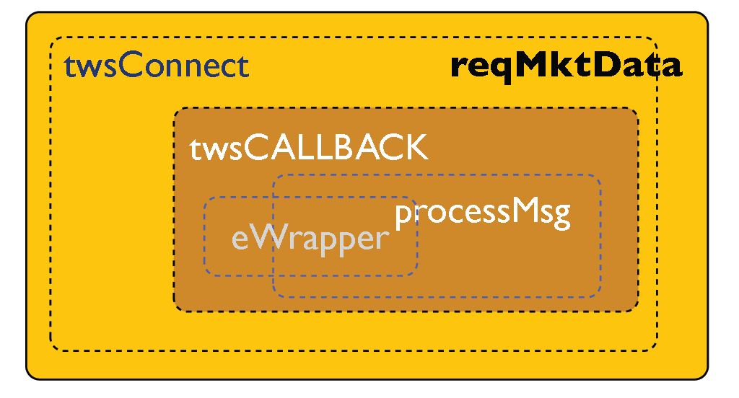
Real Time Data Model (2)
reqMktData ( tws,
Contract = twsSTK("QQQQ"),
eventWrapper = eWrapper(TRUE),
timeStamp=NULL)
1 5 1 6 36.75 0 0
1 5 1 7 36.12 0 0
45 5 1 49 0.0
45 5 1 46 3.0
1 5 1 1 36.48 3 1
2 5 1 0 3
2 5 1 2 36.49 80 1
2 5 1 3 80
2 5 1 8 978607
Notes:
In reqMktData : first parameter is the connection and second the contract
There are a series of others which effect the method’s behaviour.
Normally we specific an event wrapper into which the data is returned.
This is via a call back routine and the “message” in the eWrapper is then processed in a closure.

Slide 25
Callback routine
> twsCALLBACK
function (twsCon, eWrapper, timestamp, file, playback = 1, ...)
{
if (missing(eWrapper))
eWrapper <- eWrapper() con <- twsCon[[l]]
if (inherits(twsCon, "twsPlayback")) {
}
}
else {
while (TRUE) {
socketSelect(list(con), FALSE, NULL)
curMsg <- readBin(con, character(), 1)
if ( !is.null(timestamp) ) {
processMsg(curMsg, con, eWrapper, format(Sys.time(), timestamp), file, …)
}
}
}
}

Slide 26
Process Message
> processMsg
function (curMsg, con, eWrapper, timestamp, file, ...)
{
if (curMsg == .twsIncomingMSG$TICK_PRICE) {
msg <- readBin(con, character(), 6)
eWrapper$tickPrice(curMsg, msg, timestamp, file, ...)
}
else if (curMsg == .twsIncomingMSG$TICK_SIZE) {
msg <- readBin(con, character(), 4)
eWrapper$tickSize(curMsg, msg, timestamp, file, ...)
}
}
… # Dispatch to custom eWrapper method

Slide 27
eWrapper
Define custom message handling functions quickly and easily
> str(eWrapper())
List of 37
$ .Data :<environment: 0x307cbf0>
$ get.Data :function (x)
$ assign.Data :function (x, value)
$ remove.Data :function (x)
$ tickPrice :function (curMsg, msg, timestamp, file, ...)
$ tickSize :function (curMsg, msg, timestamp, file, ...)
$ tickOptionComputation :function (curMsg, msg, timestamp, file, ...)
$ tickGeneric :function (curMsg, msg, timestamp, file, ...)
$ tickString :function (curMsg, msg, timestamp, file, ...)
$ tickEFP :function (curMsg, msg, timestamp, file, ...)
$ orderStatus :function (curMsg, msg, timestamp, file, ...)
$ errorMessage :function (curMsg, msg, timestamp, file, ...)
$ openOrder :function (curMsg, msg, timestamp, file, ...)
$ openOrderEnd :function (curMsg, msg, timestamp, file, ...)
$ updateAccountValue :function (curMsg, msg, timestamp, file, ...)
$ updatePortfolio :function (curMsg, msg, timestamp, file, ...)
$ updateAccountTime :function (curMsg, msg, timestamp, file, ...)
$ accountDownloadEnd :function (curMsg, msg, timestamp, file, ...)
$ nextValidId :function (curMsg, msg, timestamp, file, ...)
$ contractDetails :function (curMsg, msg, timestamp, file, ...)
$ bondContractDetails :function (curMsg, msg, timestamp, file, ...)
$ contractDetailsEnd :function (curMsg, msg, timestamp, file, ...)
$ execDetails :function (curMsg, msg, timestamp, file, ...)
$ updateMktDepth :function (curMsg, msg, timestamp, file, ...)
$ updateMktDepthL2 :function (curMsg, msg, timestamp, file, ...)
$ updateNewsBulletin :function (curMsg, msg, timestamp, file, ...)
$ managedAccounts :function (curMsg, msg, timestamp, file, ...)
$ receiveFA :function (curMsg, msg, timestamp, file, ...)
$ historicalData :function (curMsg, msg, timestamp, file, ...)
$ scannerParameters :function (curMsg, msg, timestamp, file, ...)
$ scannerData :function (curMsg, msg, timestamp, file, ...)
$ scannerDataEnd :function (curMsg, msg, timestamp, file, ...)
$ realtimeBars :function (curMsg, msg, timestamp, file, ...)
$ currentTime :function (curMsg, msg, timestamp, file, ...)
$ fundamentalData :function (curMsg, msg, timestamp, file, ...)
$ deltaNeutralValidation:function (curMsg, msg, timestamp, file, ...)
$ tickSnapshotEnd :function (curMsg, msg, timestamp, file, ...)

Slide 28
Real Time Data Model (3)
twsOC <- twsConnect(2) # Our order connection
ocWrapper <- eWrapper(TRUE)
traded <- FALSE
while (TRUE) {
cons <- socketSelect(list(con, twsOC[[1]]), FALSE, 0.01)
if(cons[1]) { ## Data ##
curMsg <- readBin(con, character(), 1)
if ( !is.null(timestamp)) {
processMsg(curMsg, con, eWrapper, format(Sys.time(), timestamp), file, ...)
}
else {
processMsg(curMsg, con, eWrapper, timestamp, file, ...)
}
}
else if(cons[2]) { ## Order messages ##
curMsg <- readBin(twsOC[[1]], character(), 1)
if (!is.null(timestamp)) {
processMsg(curMsg, twsOC[[1]], ocWrapper, format(Sys.time(), timestamp), file, ...)
}
else {
processMsg(curMsg, twsOC[[1]], ocWrapper, timestamp, file, ...)
}
}
curBID <- as.numeric(eWrapper$.Data$data[[1]][3]) ## Trade Logic ##
if( !traded && !is.na(curBID) && curBID > 140.00) {
IBrokers:::.placeOrder(twsOC, twsSTK("AAPL"), twsOrder(1053, "BUY", "10", "MKT"))
traded <- TRUE
}
}

Slide 29
Conclusions
R can be used from real-time trading.
Do some online trading first.
If you still have any cash left -- try programming your strategy.
The IBrokers package is a good example of what can be achieved natively in R.
There is a new kid(-ess) on the block: Julia
Notes:
Discuss new Julia meetup group.

Slide 30

And it’s goodnight from him
Malcolm Sherrington Amis Consulting LLP
malcolm@amisllp.com
http://www.amisllp.com
mobile: 07931 287043

